Slide 1
Telescopes for Astronomy
Roland Dechesne

Slide 2
The
Telescope
Has three functions:
Collect and gather light (most important)
  Many astronomical objects are faint and more light aids in their visibility, the issue is worse with higher magnifications
Increase resolution – see finer details
Magnify (least important)

Slide 3
There’s No Single “Right” Telescope
The choice will depend on what is driving the interest in observing:
  Moon and planets (bright, usually easy to find, need crisp higher magnification for best results)
  Star clusters (bright to dim, some are very easy to find, need moderate light gathering, low to medium magnification for best results)
  Galaxies and nebulae (dim, difficult to find, need large light gathering, low magnification for best results)
You won’t likely know which will be the correct choice if you are just starting in the hobby, so pick a generalist telescope that fits your budget
Be prepared to buy a second telescope at some point

Slide 4
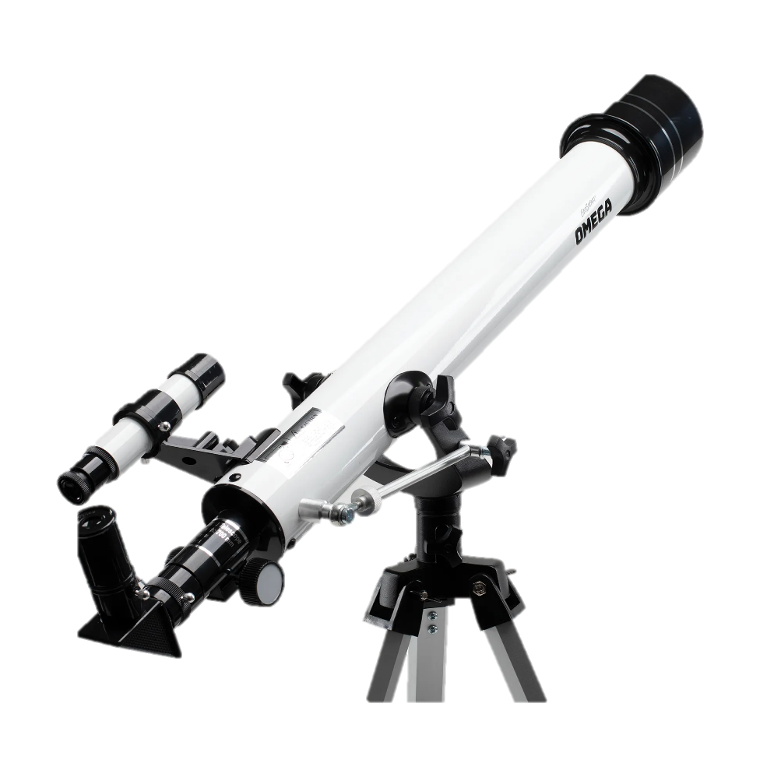
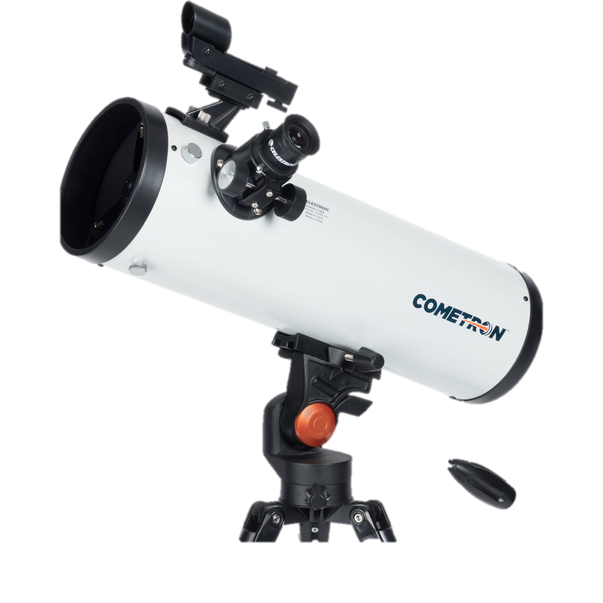
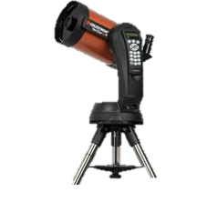
There’s No Single “Right” Telescope
Besides the choices from the previous slide regarding the 3 different classes of objects and the ‘best fit’ telescope for each, there’s 3 different telescope types:
  Refractor – ‘classical’ stereotype telescope (spyglass) uses a lens at the skyward end to collect and focus light at the focal plane
  Reflector – uses a mirror at the groundward end to collect and focus light at the focal plane
  Compound – uses a mirror at the groundward end to collect and focus light at the focal plane and corrective lenses at the skyward end

Slide 5
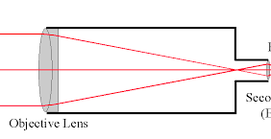
The
Refracting Telescope
The ‘refractor’ – invented by Hans Lippershey in 1608
Has a converging lens at the skyward end – fat in the middle and thin at the edge.
Eyepiece lens
Objective lens
Focus

Slide 6
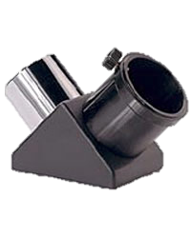
The
Refracting Telescope
The view is inherently upside-down
Commonly use a mirror accessory at the eyepiece end to provide a more comfortable viewing angle for the observer – this is called a ‘diagonal’
Creates a right-way-up image that is
  left-right reversed
Requires ‘mental gymnastics’ to
  translate what is in a chart or map
  to what’s visible in the eyepiece
Some computer programs and phone apps have an option to create upside-down or mirrored views to compensate

Slide 7
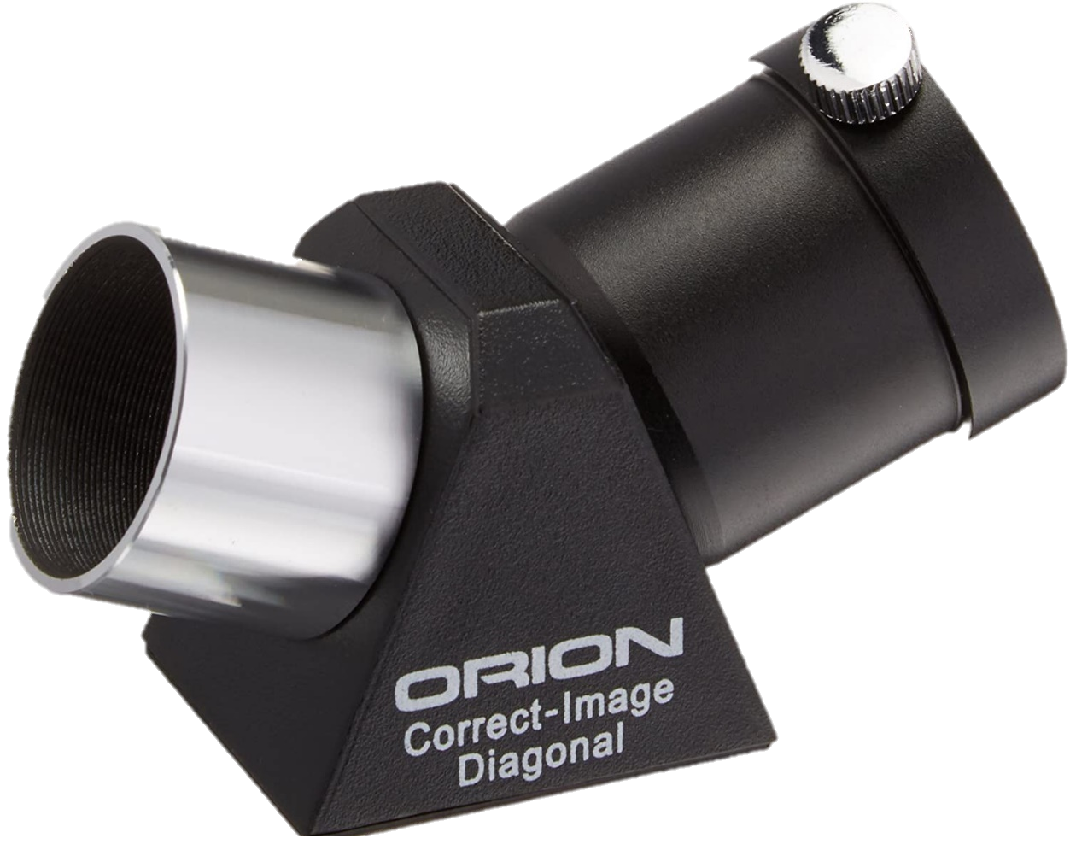
The
Refracting Telescope
A convenient option is a 45º diagonal that has an even number of internal reflections that allows for a right-way-up and correct right/left image – but at the cost of lower optical quality (scattered light primarily)

Slide 8
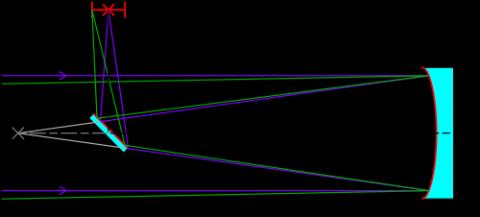
The
Reflecting Telescope
The ‘reflector’- invented by Sir Isaac Newton in 1668
He used a special metal alloy bowl-shaped mirror
Focus
Primary mirror (objective)
Secondary mirror

Slide 9
The
Reflecting Telescope
The ‘reflector’- invented by Sir Isaac Newton in 1668
He used a special metal alloy bowl-shaped mirror
Today, we typically use a bowl-shaped glass mirror with a delicate aluminum on its front surface to bring light to a focus
Internal glass quality is thus not important, and bubbles and inclusions are permissible, but larger mirrors are usually made from low expansion glasses like Pyrex
Manufacturers must ensure that the mirror’s shape is a parabola within the tolerance of better than ¼ of a wavelength of light

Slide 10
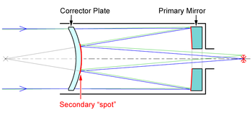
The
Compound Telescope
The ‘Cat’ (catadioptric), the ‘Schmidt’ or the ‘Mak’ (Maksutov), depending on the type of corrector plate (front lens element) were designed in the first half of the 20th Century but became popular in the 1970’s

Slide 11
General thoughts on Aperture
Usually bigger is better
Resolve finer features
See fainter objects
Power through urban light pollution
If budget is a consideration, this pushes the reflecting telescope to the front of the list
It is possible to get a telescope that is too large:
Too large or heavy to carry out of the basement for impromptu observing sessions
Too large for your vehicle
Difficult to store

Slide 12
The
Mount
Holds the telescope off the ground and maintains position
Ideally has smooth motion and no sudden lurches when starting to move (stiction)
Two main types:
Alt-az (altitude-azimuth) – up and down and left and right motions
Equatorial – has one axis parallel to the Earth’s rotation axis to facilitate tracking the stars as the Earth rotates (possibility of long exposure photographs)

Slide 13
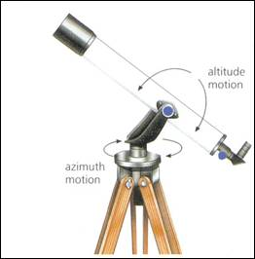
The
Mount - Alt-az
Up and down motion
Two main schools of design:
High precision metal bearings (generally small in size)

Slide 14
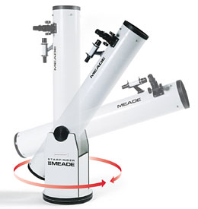
The
Mount - Alt-az
Low precision wood and plastic bearings (generally large in size) – pioneered by John Dobson – commonly called the Dobsonian mount
Since Newtonian reflectors are usually mounted in this way, the term “Dobsonian” is commonly but incorrectly applied to the whole telescope

Slide 15
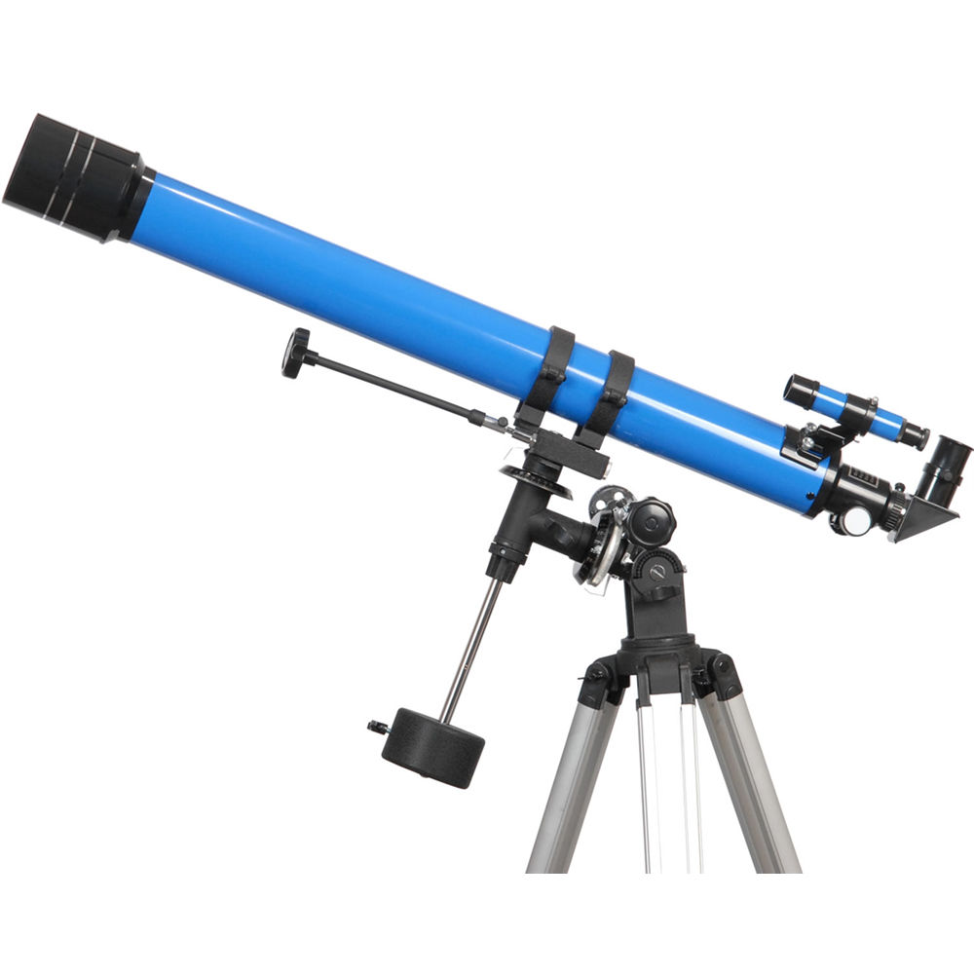
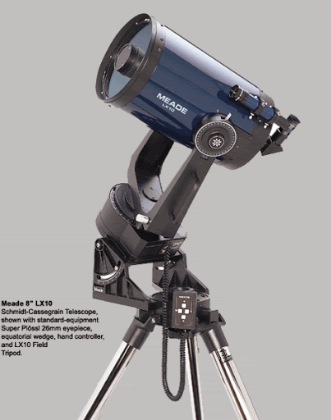
The
Mount - Equatorial
Many different configurations but the 2 most common types are either German or Fork (1 arm or 2 arm varieties)
German equatorial mounts have a counterweight and are inherently unstable without both the telescope and the counterweight mounted – lots of pinched fingers and crushed hands as the mount swings about if not locked

Slide 16
The
Mount - Equatorial
Many different configurations but the 2 most common types are either German or Fork (1 arm or 2 arm varieties)
German equatorial mounts have a counterweight and are inherently unstable without both the telescope and the counterweight mounted – lots of pinched fingers and crushed hands as the mount swings about if not locked
Both can be motor driven to automatically follow the stars if properly aligned (assuming you can find Polaris, the Pole Star)
Almost all Fork mounts have a motor but relatively few inexpensive German mounts do

Slide 17
The
Mount
In the beginner telescope price range, avoid the German equatorial designs
They look ‘sciency’ but the stereotype doesn’t follow through in the performance.
They are unstable, and prone to shaking in the wind (every shake is magnified by the power you are looking at, say 75X)

Slide 18
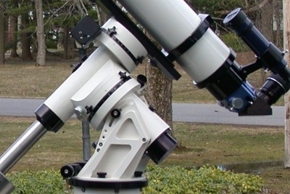
The
Mount
High quality German equatorial mounts are available, but the mount alone will cost much more than the beginner telescopes you are likely to purchase

Slide 19
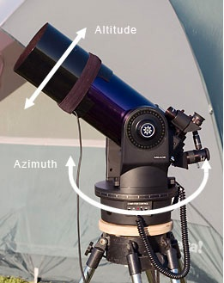
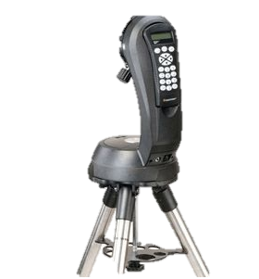
The
Mount
Computer-controllers may be used in conjunction with alt-az mounts to track the stars visually
Can be used for short camera exposures, combine many photos in Photoshop or Lightroom to get the equivalent of a single long exposure

Slide 20
Eyepieces for Beginner Telescopes
Magnification – why we need an eyepiece in the first place
Allows the observer to get closer to the focal plane
Smaller numbers mean you can get closer in and thus magnify more at the cost of the field of view
Usually values in the 4, 6, 7, 10, 12, 13, 15, 20, 25, 32, 35, 40 mm range
The magnification of a telescope system is calculated by dividing the scope’s focal length by that of the eyepiece:
  700 mm / 25 mm = 28X

Slide 21
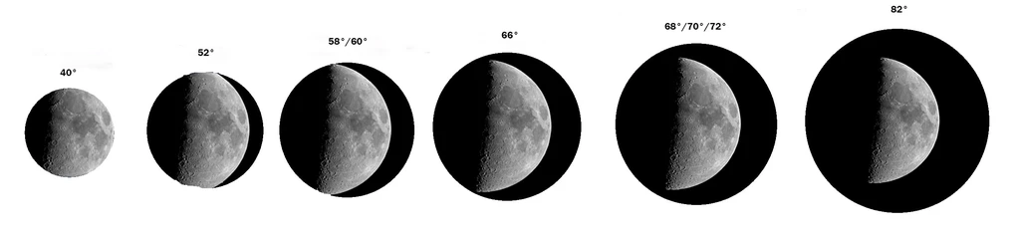
Eyepieces for Beginner Telescopes
Why the emphasis on field of view?
  Fits larger objects in view for any given magnification
  In non-tracking telescopes, allows longer viewing periods while the spinning Earth gradually moves objects out of the view

Slide 22
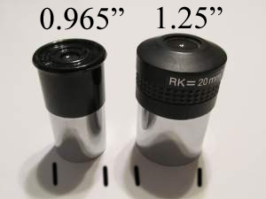
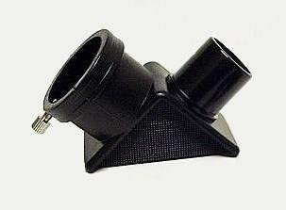
A Note
About Eyepieces
Do not buy a telescope that has 0.965” eyepieces
They are invariably inferior in quality and difficult eyepieces to source in high quality
However, if you already have such a telescope, there are hybrid 0.965” to 1.25” diagonals that allow you to buy better eyepieces

Slide 23
A Note About Magnification
Many “hobby killer” telescopes are sold on the basis of outrageous magnifications
A telescope of a given size can only resolve fine details to a theoretical limit, and actual telescope quality and particularly an unstable atmosphere above will severely limit this theoretical limit
Magnification past a certain limit will not show any further fine details, but will spread the light out too much, a real problem in a small telescope that doesn’t gather much light in the first place
Any wind vibration is also magnified
Typical maximum values are 50X per inch of aperture, or 2X per mm of aperture and these high magnifications are used very rarely

Slide 24
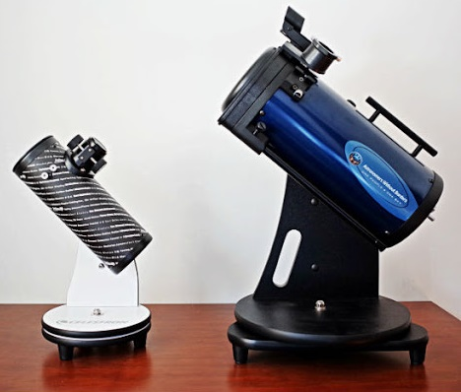
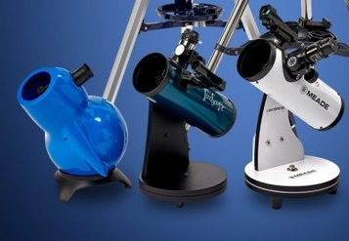
Tabletop Reflectors
Sky-Watcher Infinity-76P
Orion FunScope 76mm
Sky-Watcher Heritage-76
Meade LightBridge Mini 82
Celestron Firstscope 76
  $80 All-Star Telescope
AWB OneSky Telescope 130

Slide 25
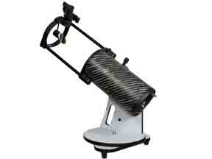
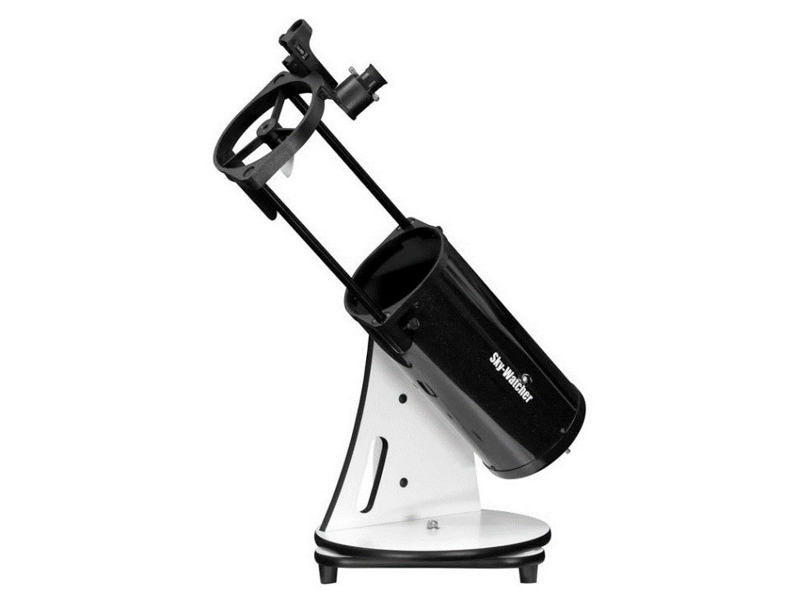
Tabletop to Ground Level Reflectors
Sky-Watcher Heritage 130mm Collapsible
  $300 All-Star telescopes, temporarily out of stock
Sky-Watcher Heritage 150 Collapsible
$370 All-Star Telescopes
Orion StarBlast Telescopes 114 and 150 are similar - other suppliers

Slide 26
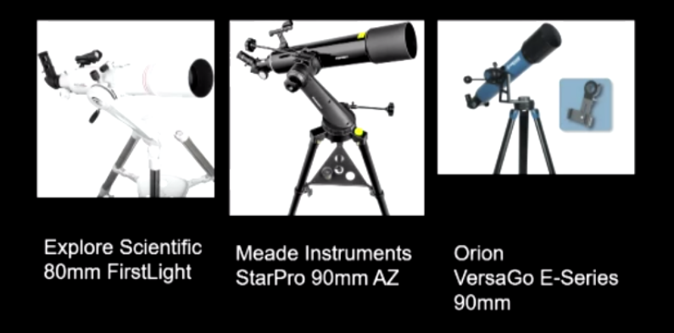
Refractors
In a recent SkyNews Magazine Alan Dyer reviewed three telescopes that cost around $300
All are on alt-az mounts
The StarPro 90 has a holder for a smart phone so it can image the night sky and figure out where you are pointed, and which way you need to push to get to a target object

Slide 27
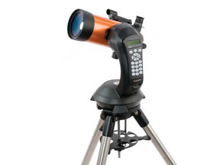
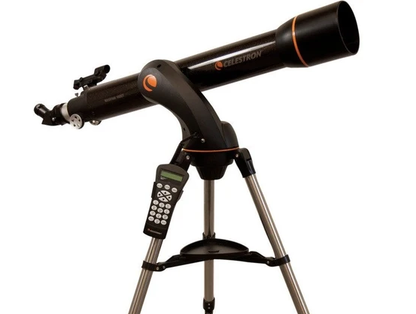
Celestron
NexStar Series
4SE Compound
$690.00 at All-Star Telescopes
GT 102 refractor
Not carried by All-Star Telescopes

Slide 28
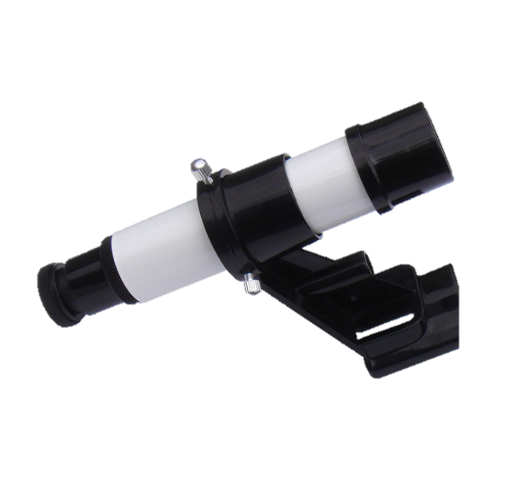
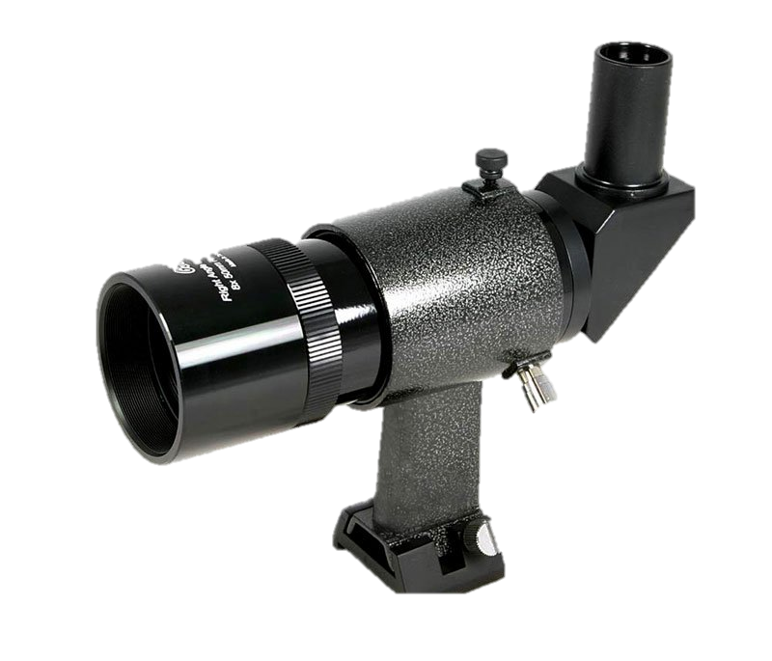
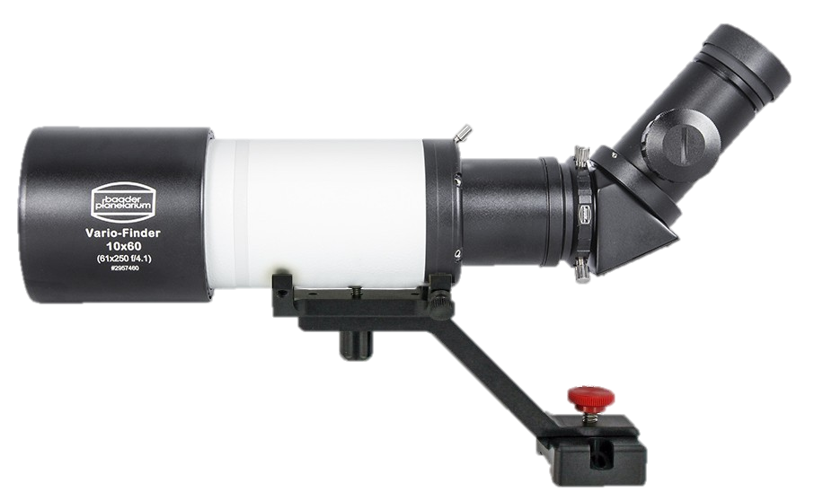
Best Add-ons for Telescopes
Good finderscope
  At least 30 mm aperture, ideally 50 mm
  avoid the common 24 mm aperture ones (junk)
  Depending on the type of telescope, choose a straight-through (Newtonian Reflectors) or right-angle (Refractor or Compound)
  A right-way-up, left-right correct finderscope with a 45º diagonal will work for any telescope design
  A quality finderscope acts as a ultra wide-angle telescope

Slide 29
Best Add-ons for Telescopes
Wide-angle eyepiece
  Commonly in the 27-35 mm focal length range
  Look for a ‘WA’, ‘Wide-Angle’, Plossl or Erfle design

Slide 30
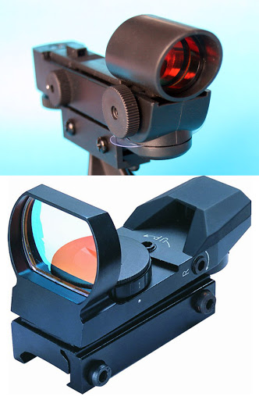
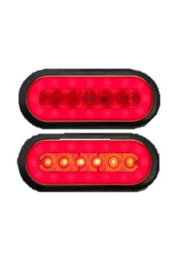
Other
Accessories
‘Red Dot’ finder – astronomy supply stores
Red light flashlight for preserving night vision, while looking at charts, or finding an eyepiece – sporting goods stores

Slide 31
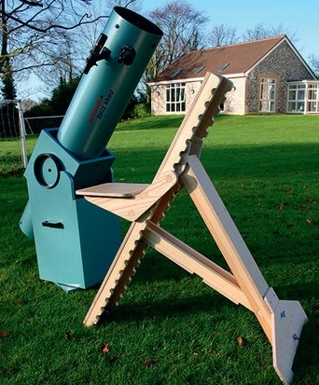
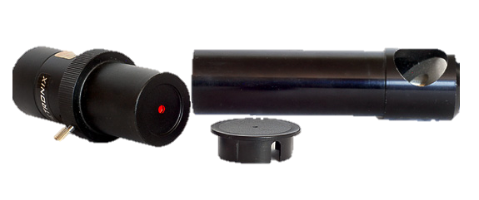
Other
Accessories
For Newtonian reflectors – collimation tool
Extended dew (or frost) shields for compound telescopes
Compact portable cooler equipped with hot packs to defrost or de-dew eyepieces (and smart phone)
External battery pack for computer-controlled telescopes (AA batteries don’t so well in cold weather)
Observing chair – adjustable height

