Slide 1
Starting Out in Visual Astronomy: June 2021
Royal Astronomical Society of Canada – Calgary Centre
calgary.rasc.ca
www.facebook.com/CalgaryRASC
@CalgaryRASC
www.youtube.com/RASCCalgary

Slide 2

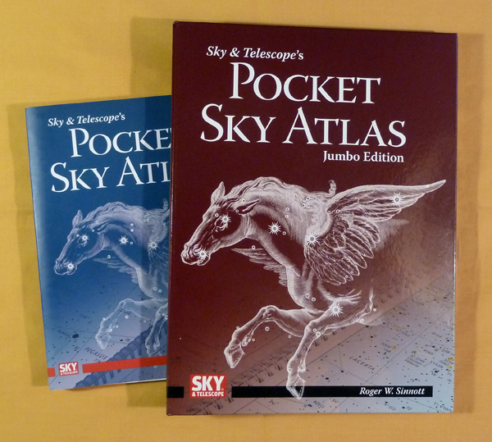
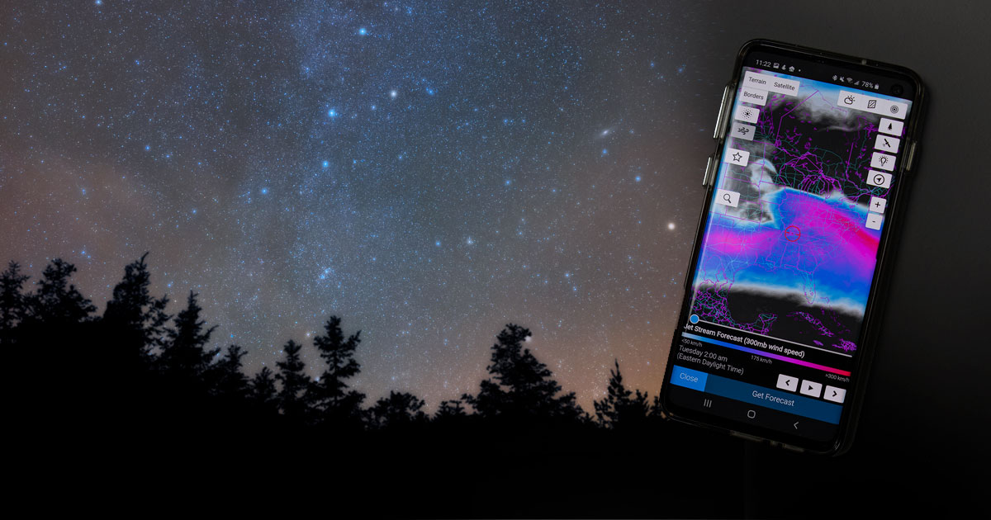
Reference Material
Books & Software

Slide 3
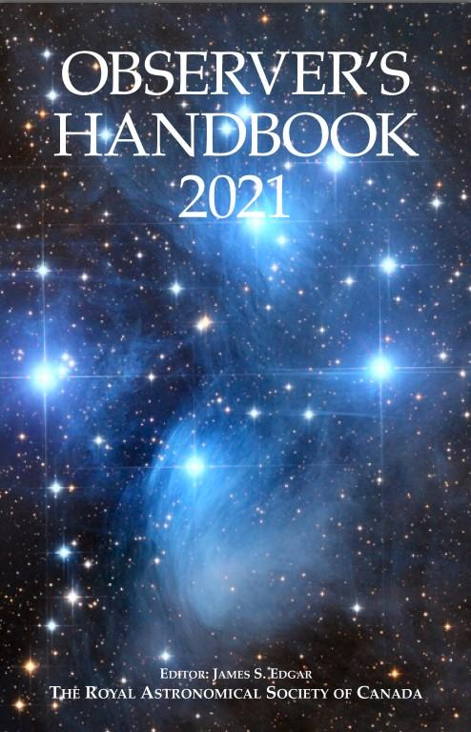

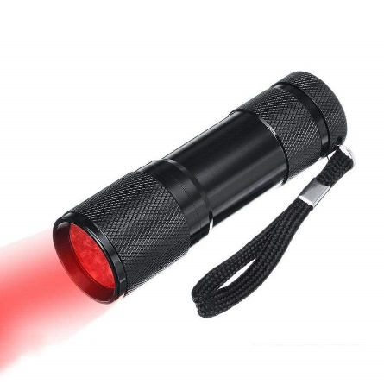

Reference Material
Books

Slide 4
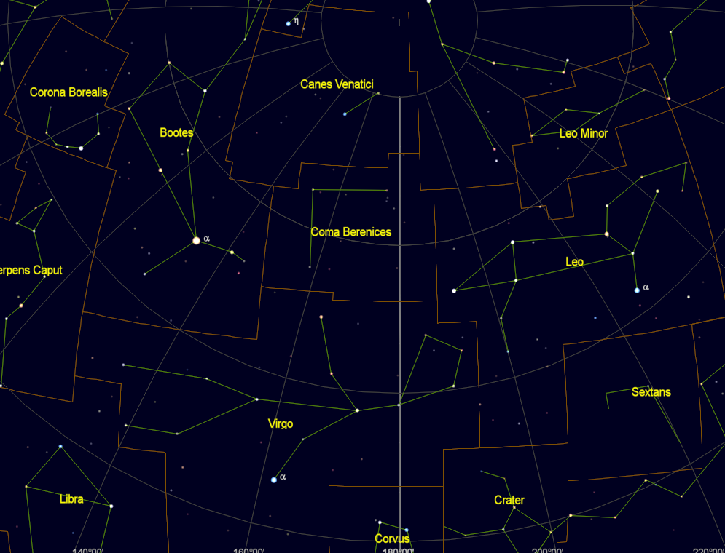
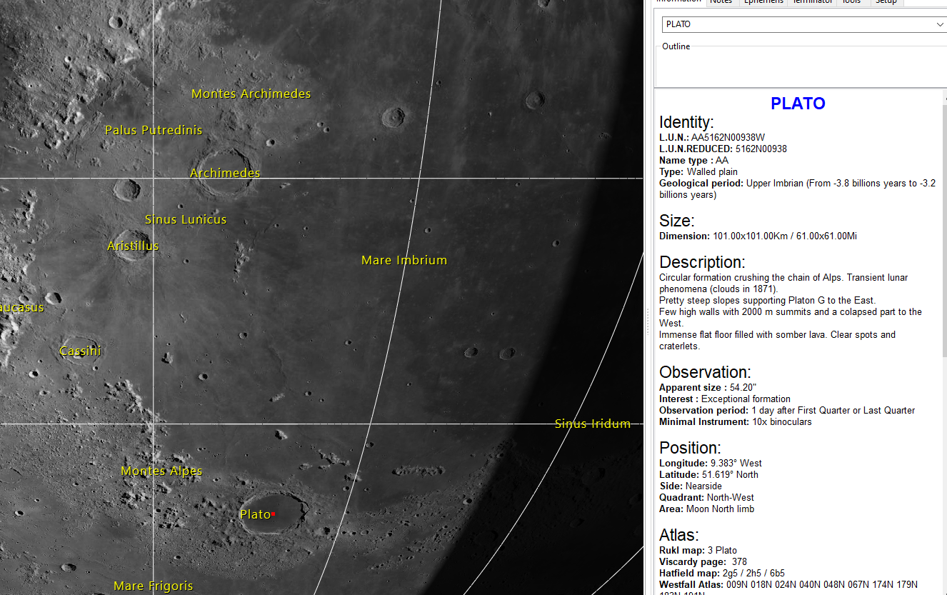
Reference Material
Software
Cartes du Ciel
Virtual Moon Atlas
Stellarium

Slide 5
Reference Material
Apps
Application | Purpose
Astrospheric | Weather
Space Weather Live Link | Solar Weather
Moon Phase Calculator | Moon Information
Moons of Jupiter | Location of Jupiter’s Moons
Moons of Saturn | Location of Saturn’s Moons
Sky Map | Sky Mapping
Stellarium | Sky Mapping
Using a device or white flashlight may cause you to lose good night adapted vision for up to an hour

Slide 6
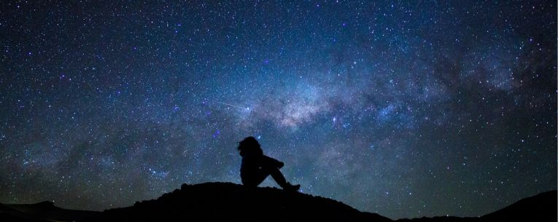
What’s Up in the Sky
Summer 2021

Slide 7
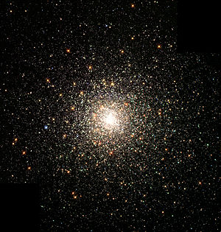
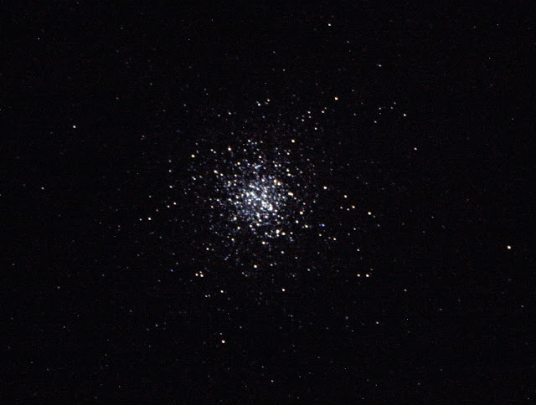
What is a Globular Cluster?
It is a spherical group of stars held tightly by gravity. They are normally found on the edge of galaxies.

Slide 8
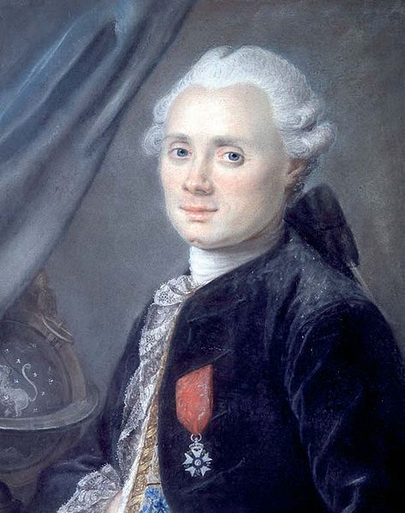
What is a Messier Object?
Charles Messier (26 June 1730 – 12 April 1817) was a French astronomer most notable for publishing an astronomical catalogue consisting of deep sky objects such as nebulae and star clusters that came to be known as the 110 "Messier objects".
The purpose of the catalogue was to help astronomical observers, in particular comet hunters such as himself, distinguish between permanent and transient visually diffuse objects in the sky.
When you see an object denoted M#, that is a Messier Object.

Slide 9
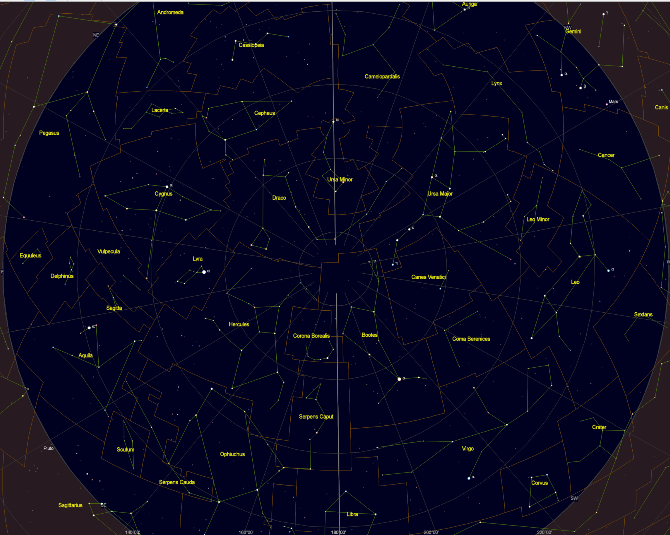
Summer 2021 Sky
Where do you start?
Constellations & Asterisms, break up the sky into chunks

Slide 10
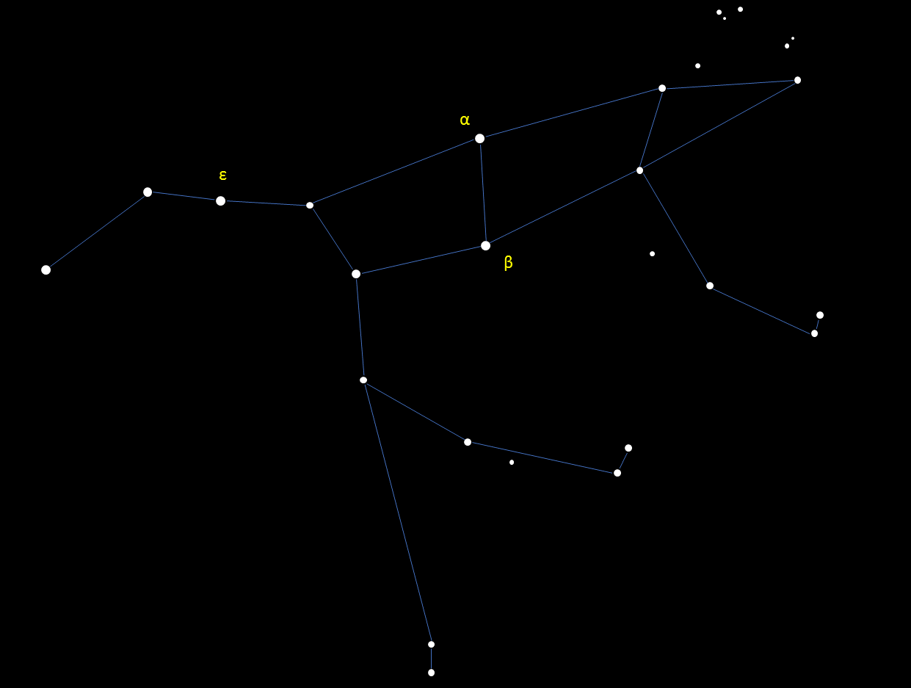
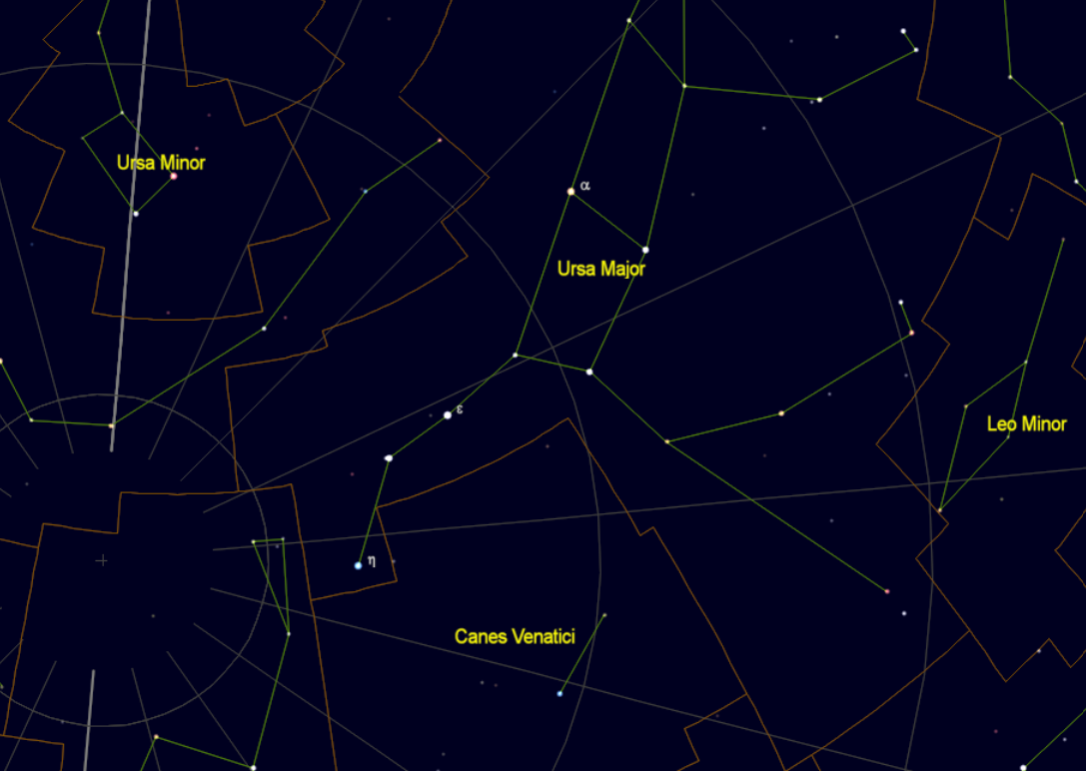
Ursa Major
Located in the NW sky nearly above your head
NW

Slide 11
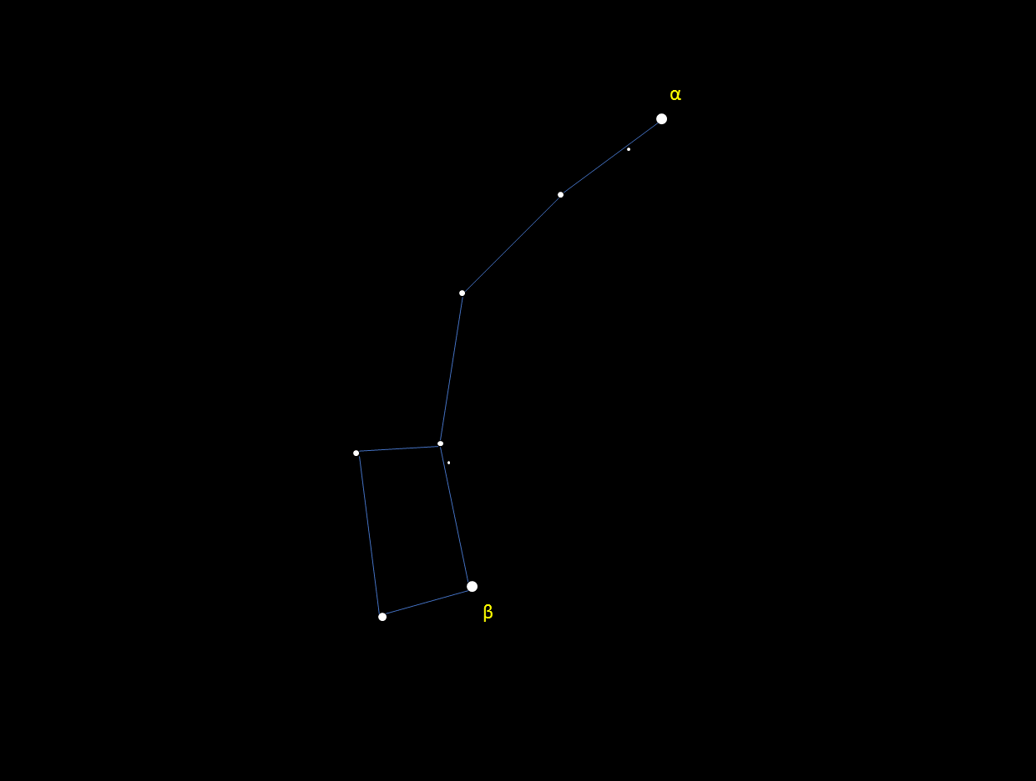
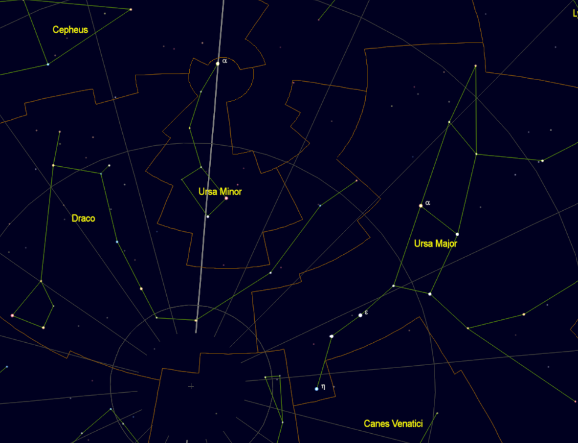
Ursa Minor
Use the spoon end of the Big Dipper to point to the North Star which is the tip of the Little Dipper; the asterism of Ursa Minor
N

Slide 12
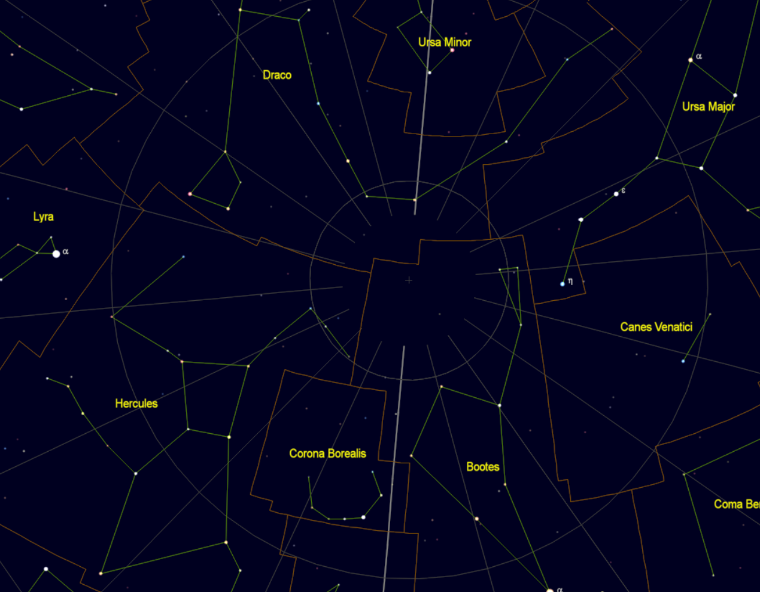
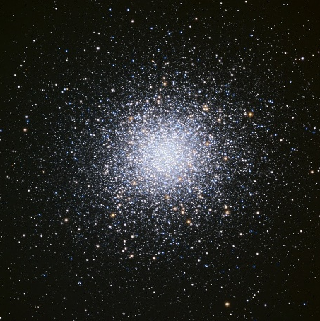
Hercules
Look in the E sky
Follow the straight handle part of the Big Dipper towards the east
You should see a large ‘keystone’ like shape. This is the body of Hercules
β
E
Messier 13

Slide 13
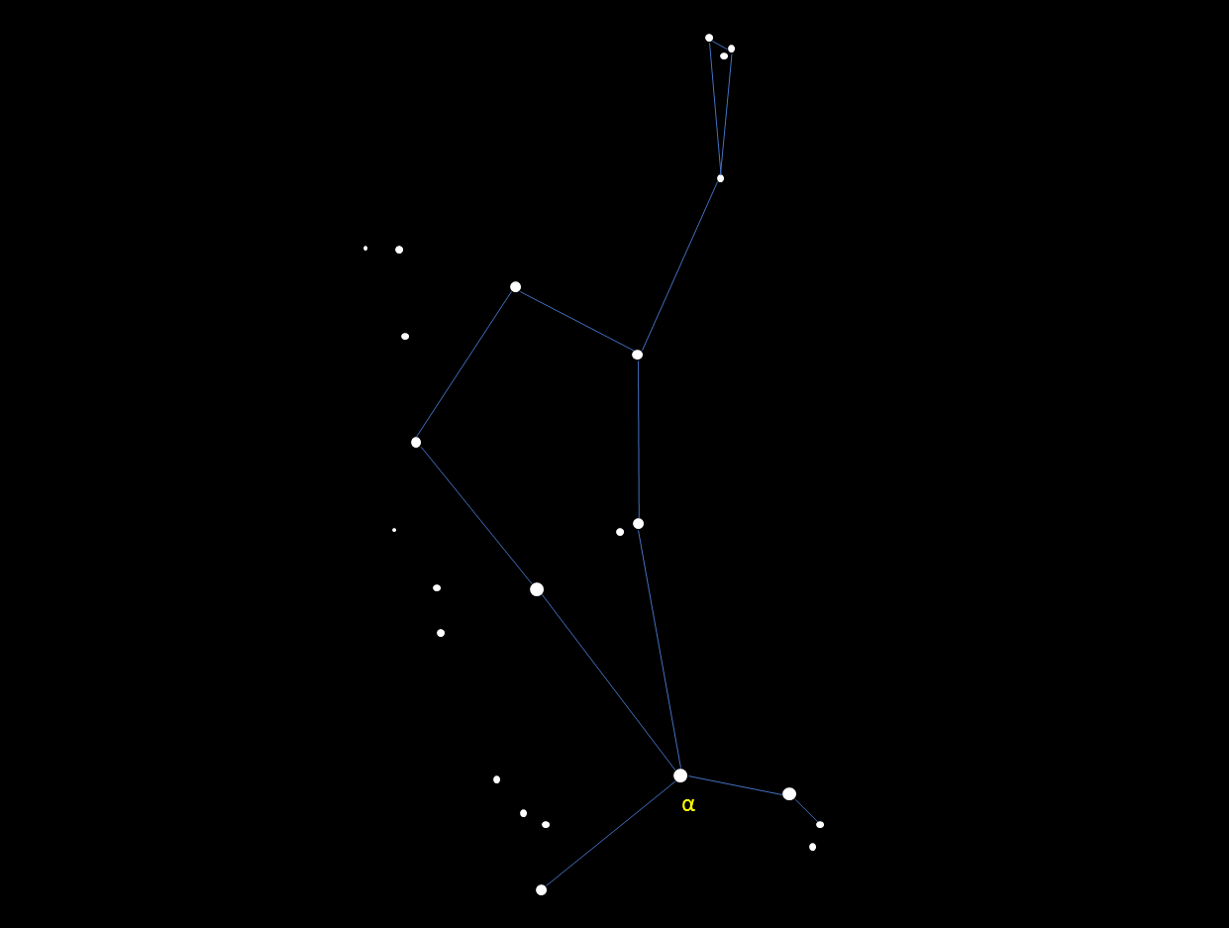
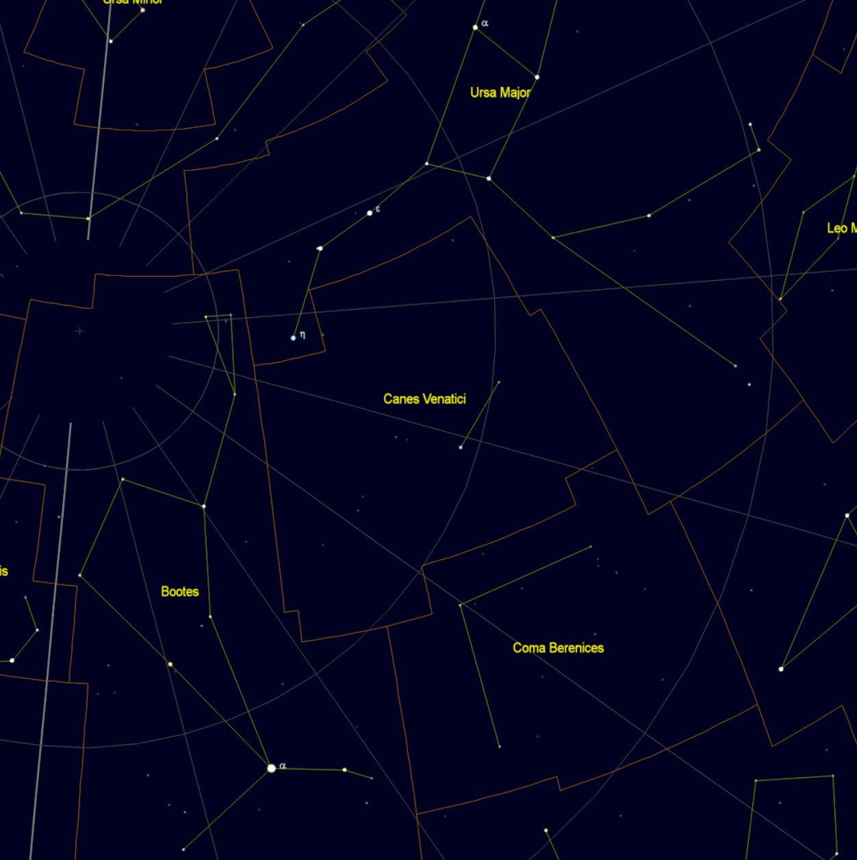
Boötes
Arc back from the handle of the Big Dipper to the bright red star Arcturus in Boötes. “Arc to Arcturus”.
S

Slide 14
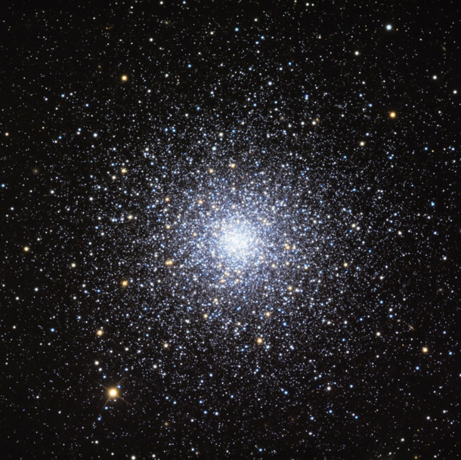
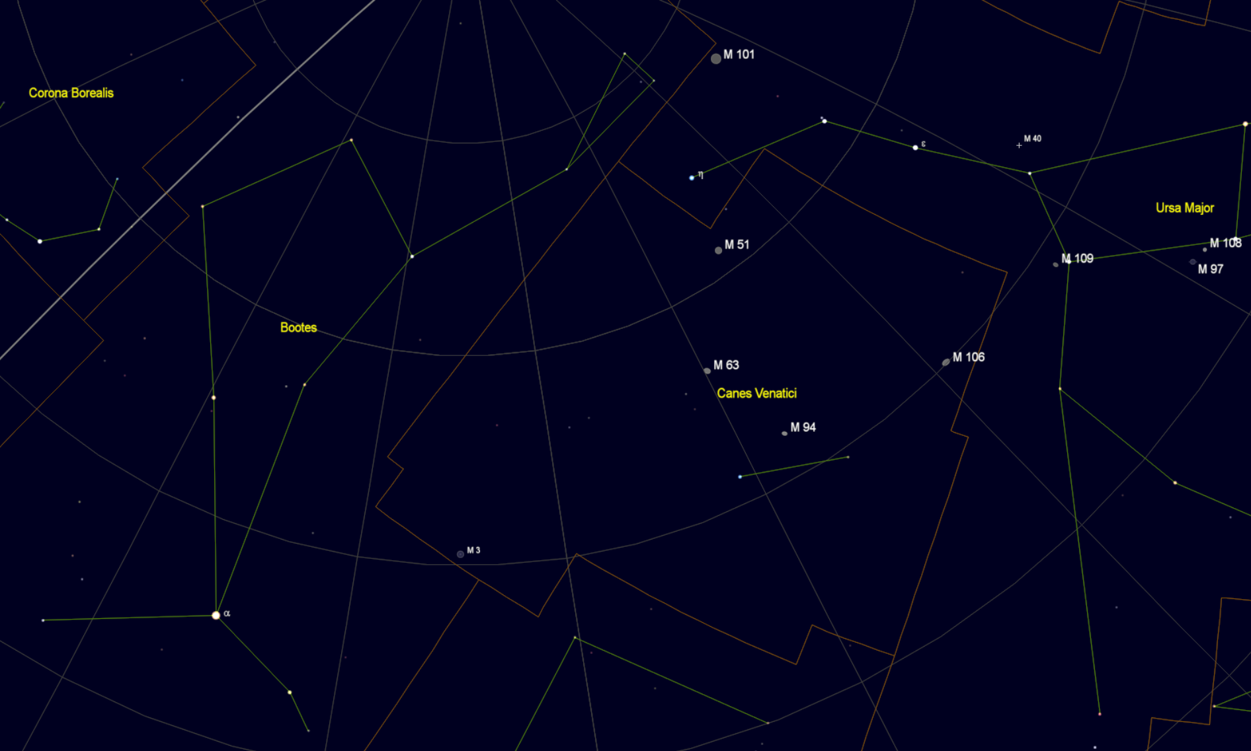
Messier 3
Globular Cluster found between two bright stars in the southern sky
β
α
S

Slide 15
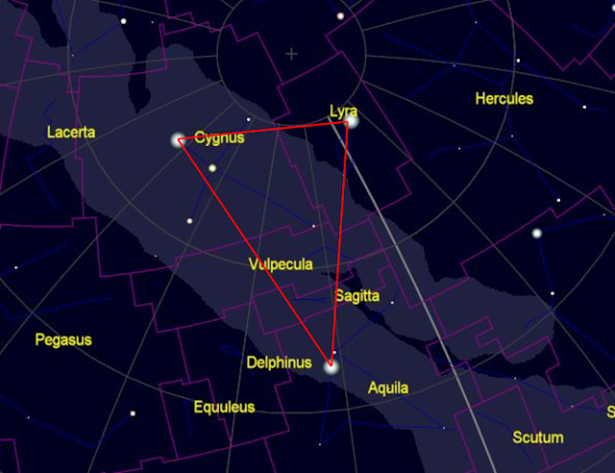
The Summer Triangle
Look overhead when it is dark during the middle of summer
There will be three bright stars forming a triangle pointing to the S

Slide 16
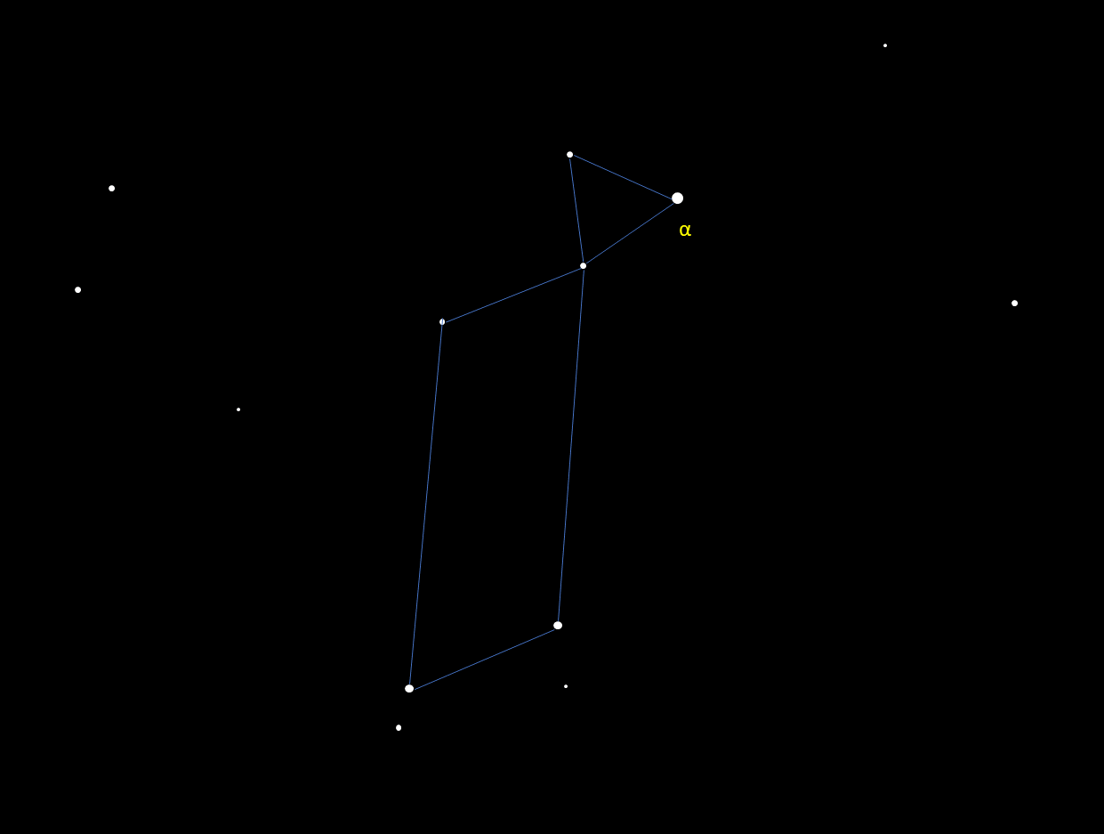
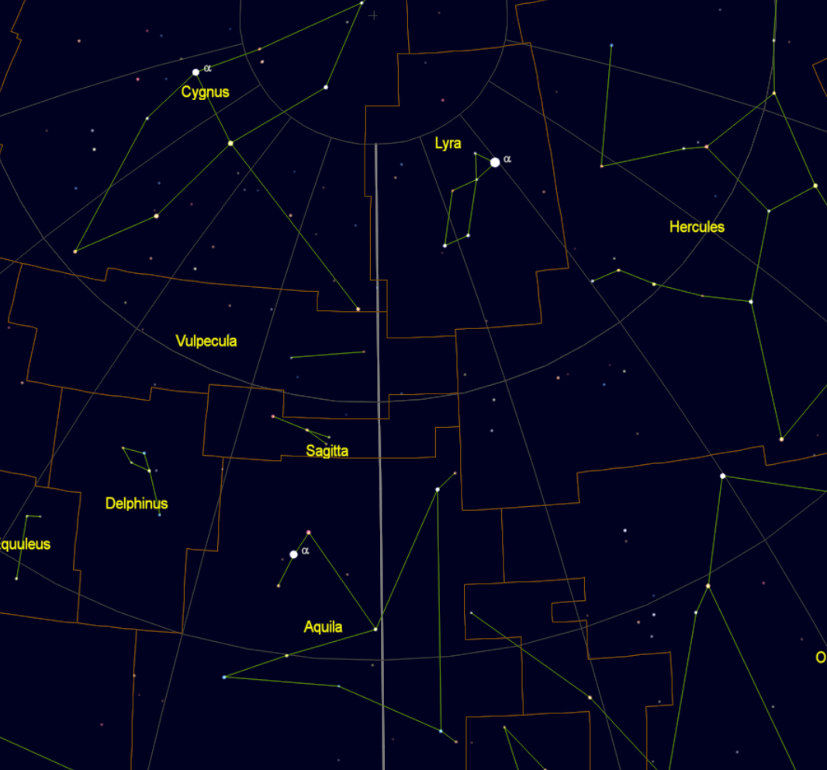
Lyra
Contains Vega, one of the brightest stars in the northern skies
Can be found east of Hercules
Forms the northwestern corner of the Summer Triangle
E
Overhead

Slide 17
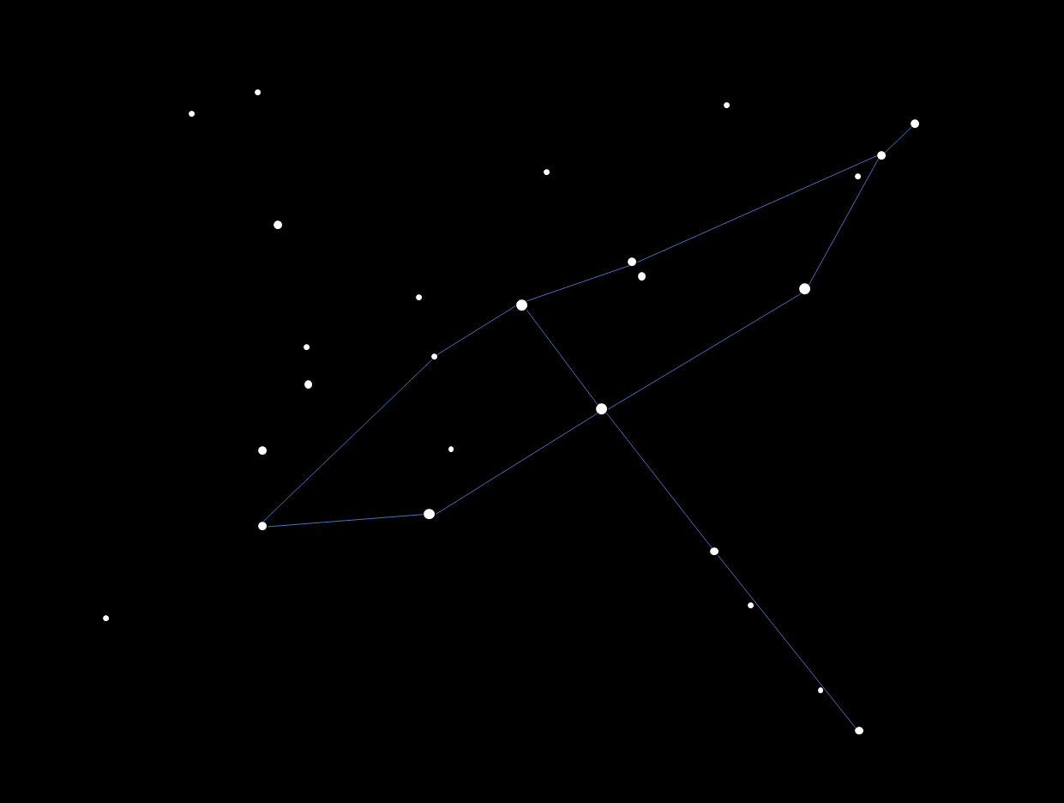
Cygnus
Can be found east of Lyra
Looks like a cross, also known as “The Northern Cross”
Forms the northeastern corner of the Summer Triangle
α
E
Overhead
β

Slide 18
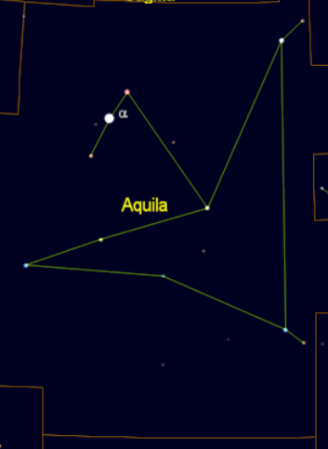
Aquila
Southernmost bright star of the Summer Triangle
Found below Lyra and Cygnus
E
Overhead
S

Slide 19
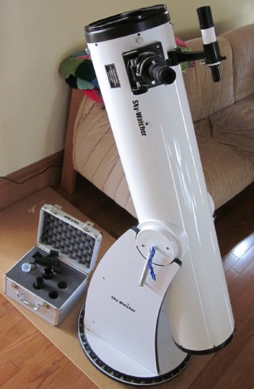
Astronomy Equipment
Fill Out the Poll!
Telescopes

Slide 20
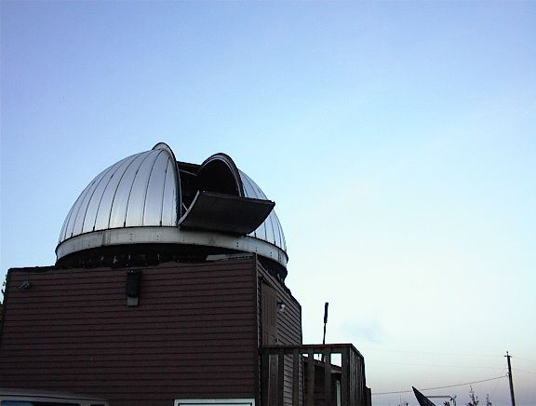
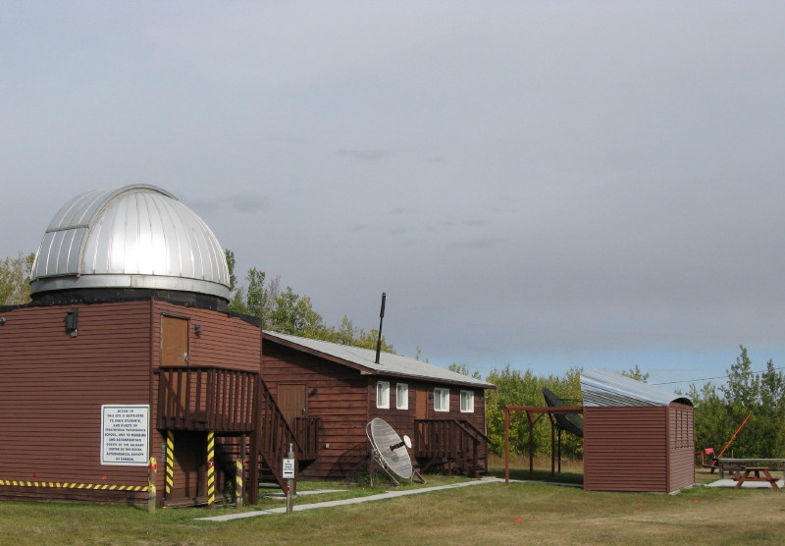
Live From the WCO
RASC Observatory

Slide 21
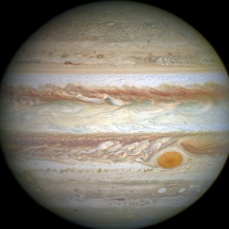
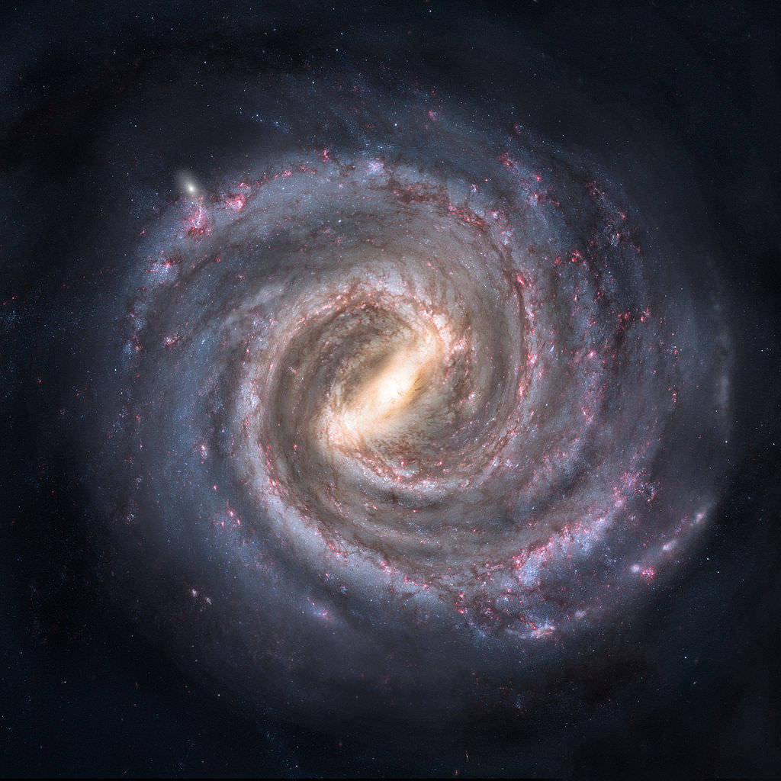
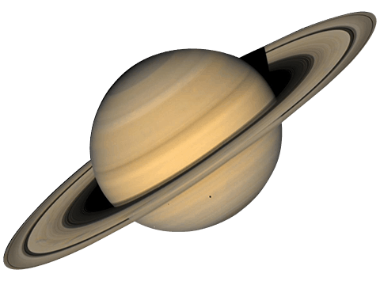
More Summer Sights
Solar System and Milky Way

Slide 22
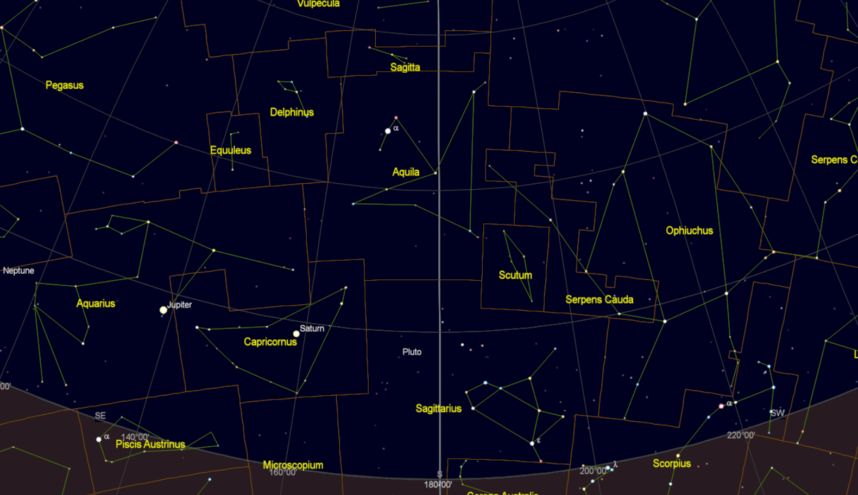
The Solar System
August: 12:00am

Slide 23
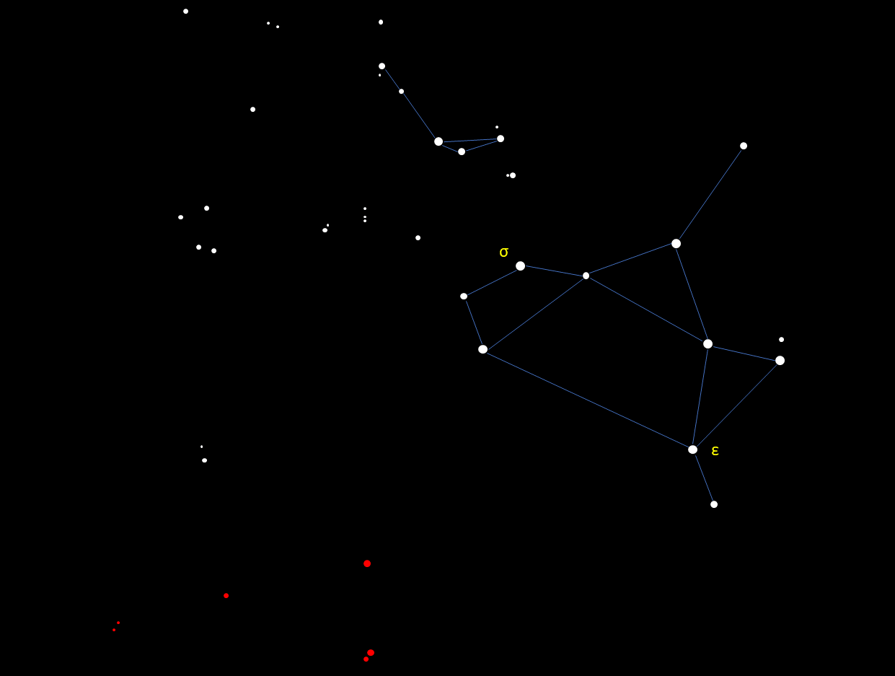
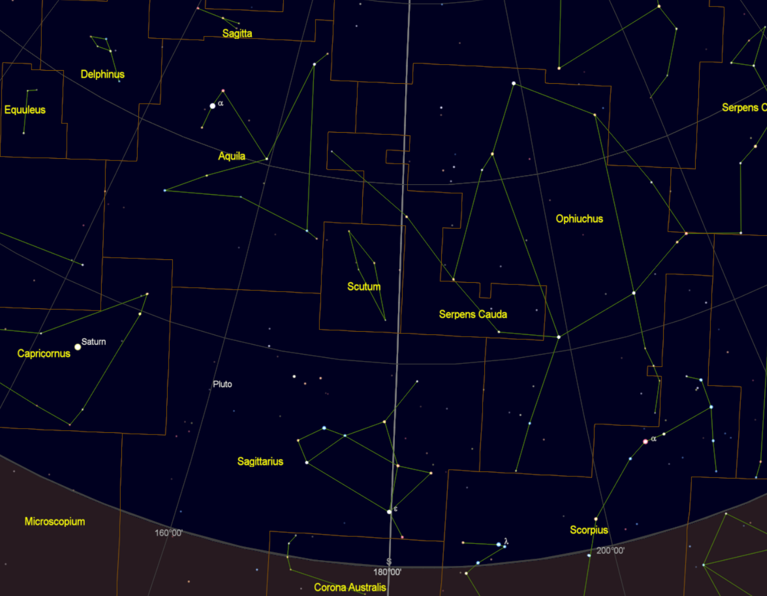
Sagittarius
Found on the southern horizon during summer
Stars in red are below horizon from Calgary at all times throughout the year.
S

Slide 24
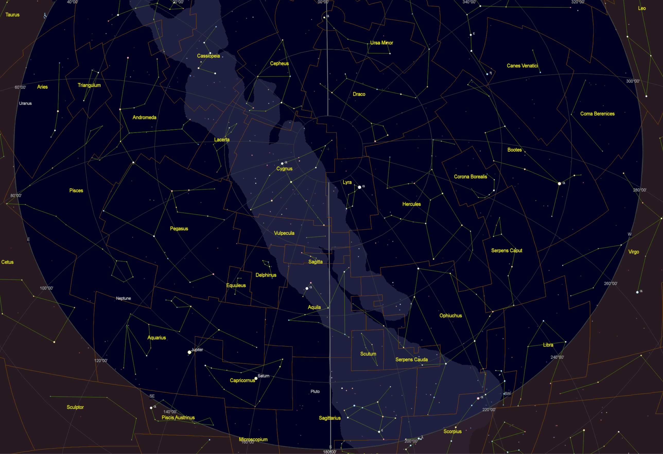
The Milky Way
Get to dark skies!
Follow the Milky Way from the South across over your head

Slide 25
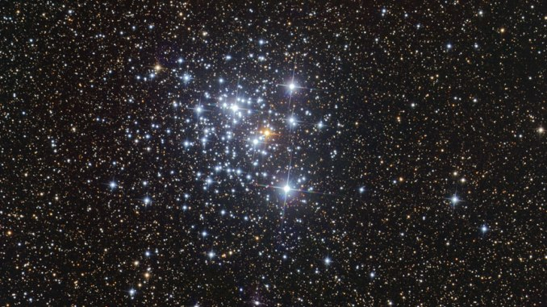
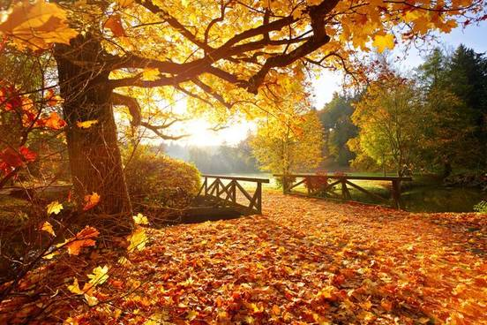
Next Time
Open Clusters
Equipment
Prepare for Fall

Slide 26
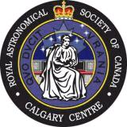
Learn More
Royal Astronomical Society of Canada

Slide 27

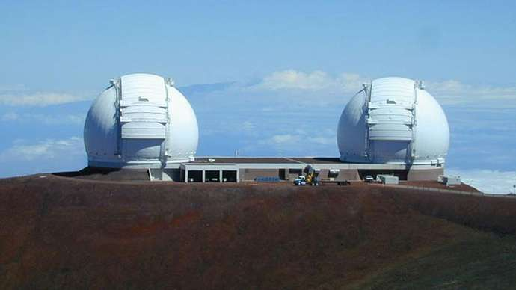
Fuel tank, Waste Dump, and Recycling Center: The Circumgalactic Medium Over Cosmic Time
John O’Meara
W.M. Keck Observatory
Online
July 15, 2021: 7:30-9:00 MDT

Slide 28
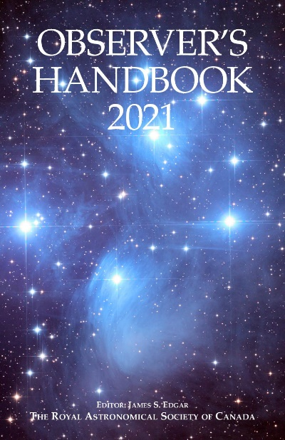




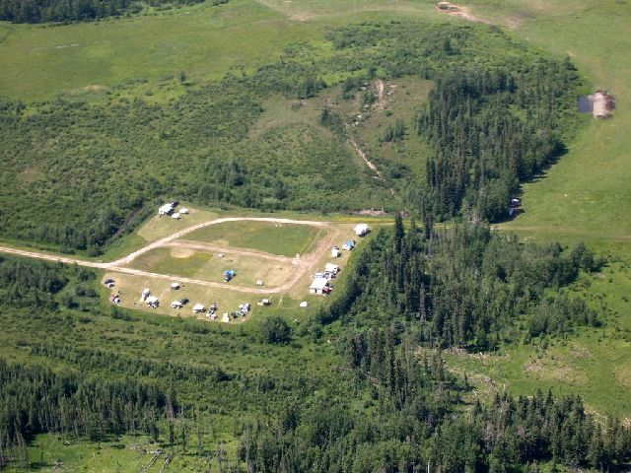


Join Us Today
https://www.rasc.ca/
www.facebook.com/CalgaryRASC
www.twitter.com/CalgaryRASC
www.youtube.com/RASCCalgary
Contact President:
simonjastronomy@gmail.com
@simonjastronomy
calgary.rasc.ca
Download Files

